Slide 1
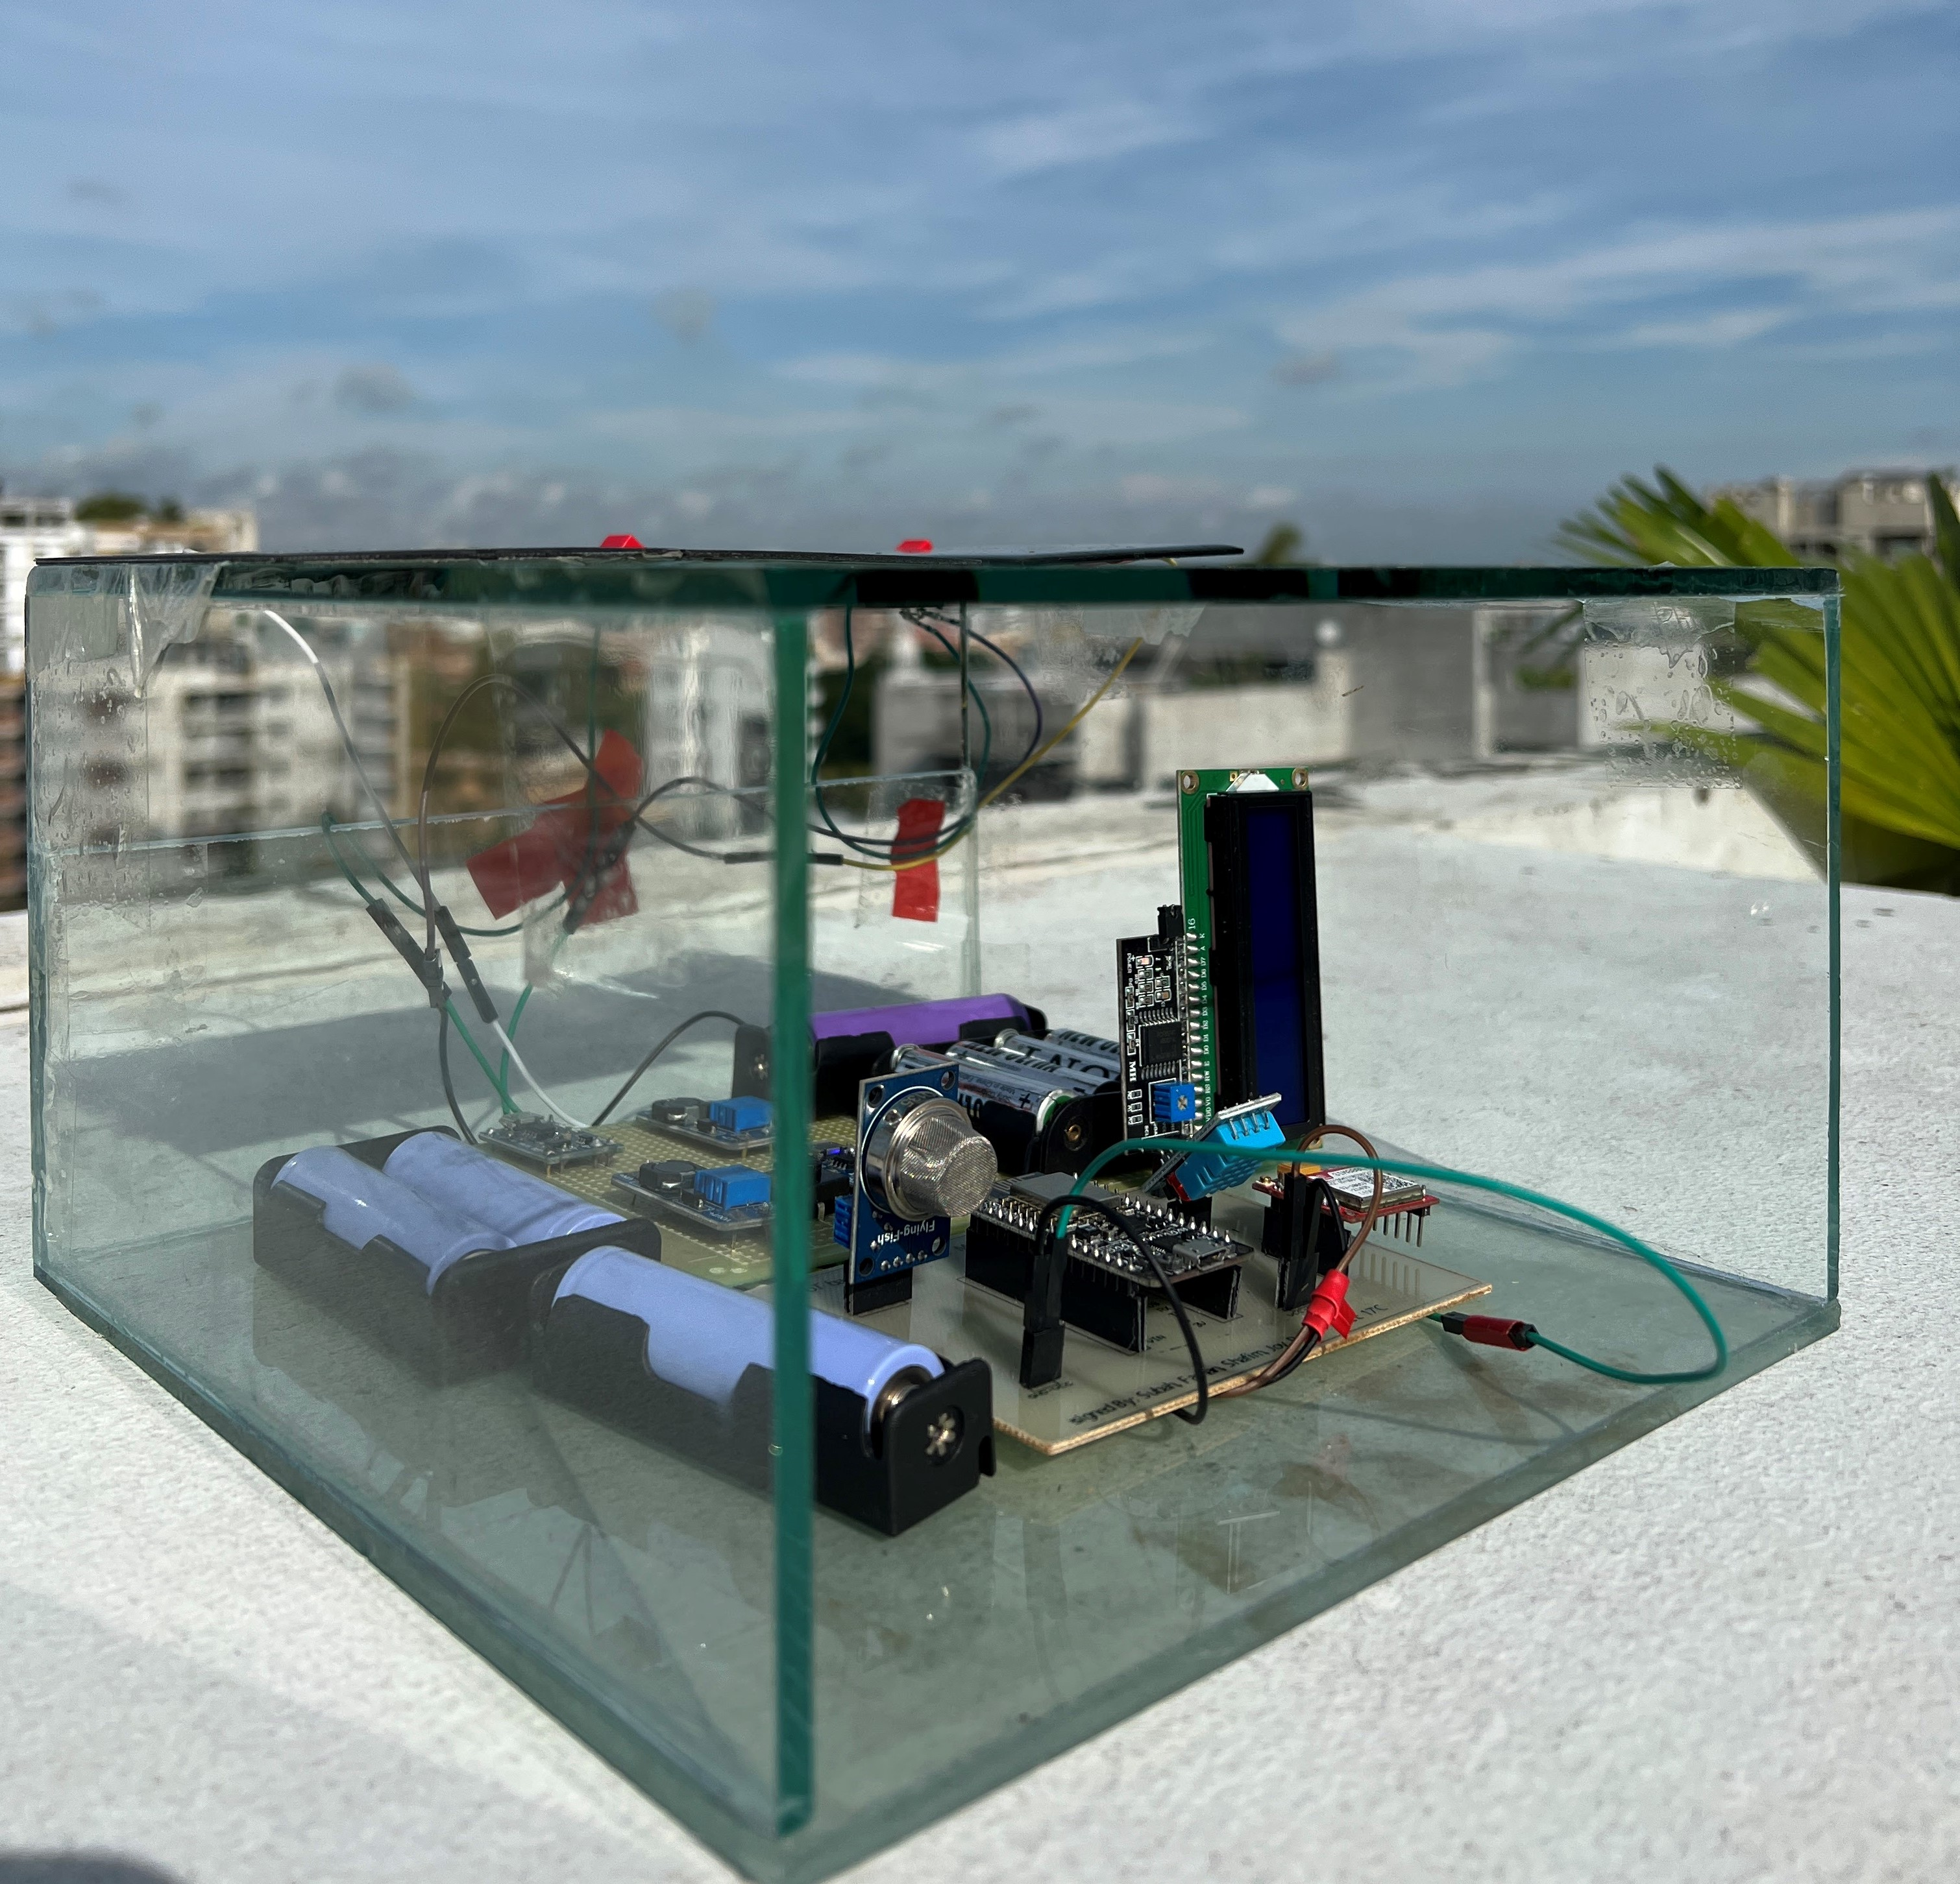





IoT Based Environment Monitor System
C
Submitted by – Group C2.05
Shafim Bin Hassan
Mostakin Ahmed Rafat
1706173
Subah Karnine
1706174
Farhan Hamid
1706175
Joy Saha
1706189
1706172

Slide 2
Outline
Summary
Introduction
Design
Implementation
Analysis and Evaluation
References
Presented by: 1706173

Slide 3
1. Summary / Abstract
In this EEE416 sessional course we have built an IoT based environment monitoring system with integrated GSM technology. Two sensors work to find the temperature, humidity and the air quality. The values are uploaded online to a cloud system where it is shown and recorded. Warning message is sent straight to the users phone when the parameters exceed a given threshold. The entire system is powered with solar energy with battery backup.
Presented by: 1706173

Slide 4
2. Introduction
The air we breath in has a direct effect on our health. As such ensuring a healthy environment with good quality air should be imperative. The first step to do so is to monitor our surrounding environment. The monitor system we have built can help us get real time reading of the air quality remotely. With this we can identify the activities directly affecting the surrounding air and help maintain a healthy environment.
Presented by: 1706173

Slide 5
3.1 Design: Components
The components used in this project are:
Main Circuit Components:
NodeMCU ESP8266 microcontroller
DHT11: Temperature and Humidity sensor
MQ135: Gas sensor
SIM800L
I2C adapter
LCD display
Presented by: 1706173

Slide 6
3.1 Design: Components
The components used in this project are:
Solar circuit components:
6V solar panel
TP4056 battery charger
MT3608 boost converter
Switch (DPST and SPST)
Presented by: 1706173

Slide 7
3.1 Design: Sensors
Main Circuit:
The two sensors used are DHT11 and MQ135.
DHT11 detects air temperature and humidity.
MQ135 detects gases in air like ammonia, sulfide, smoke, carbon di-oxide etc. It measures the gas particles in air in ppm and can give a rough estimate about the change in air quality.
Presented by: 1706189

Slide 8
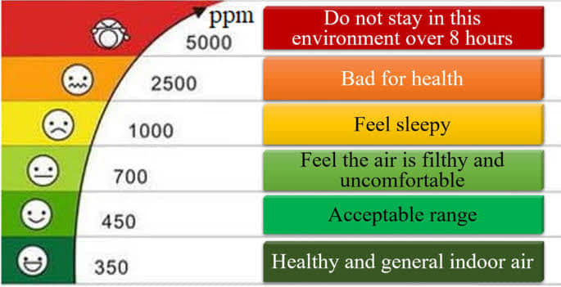
3.1 Design: Sensors
A chart showing the levels of CO2 in air
Presented by: 1706189

Slide 9
3.1 Design: Solar Power
The main circuit is connected to two 6V solar panels through a rechargeable battery. The battery is connected with a boost converter to boost up the battery when indoors.
The GSM module is connected in the same way with one 6V panel to provide it with the power needed to operate.
Presented by: 1706189

Slide 10
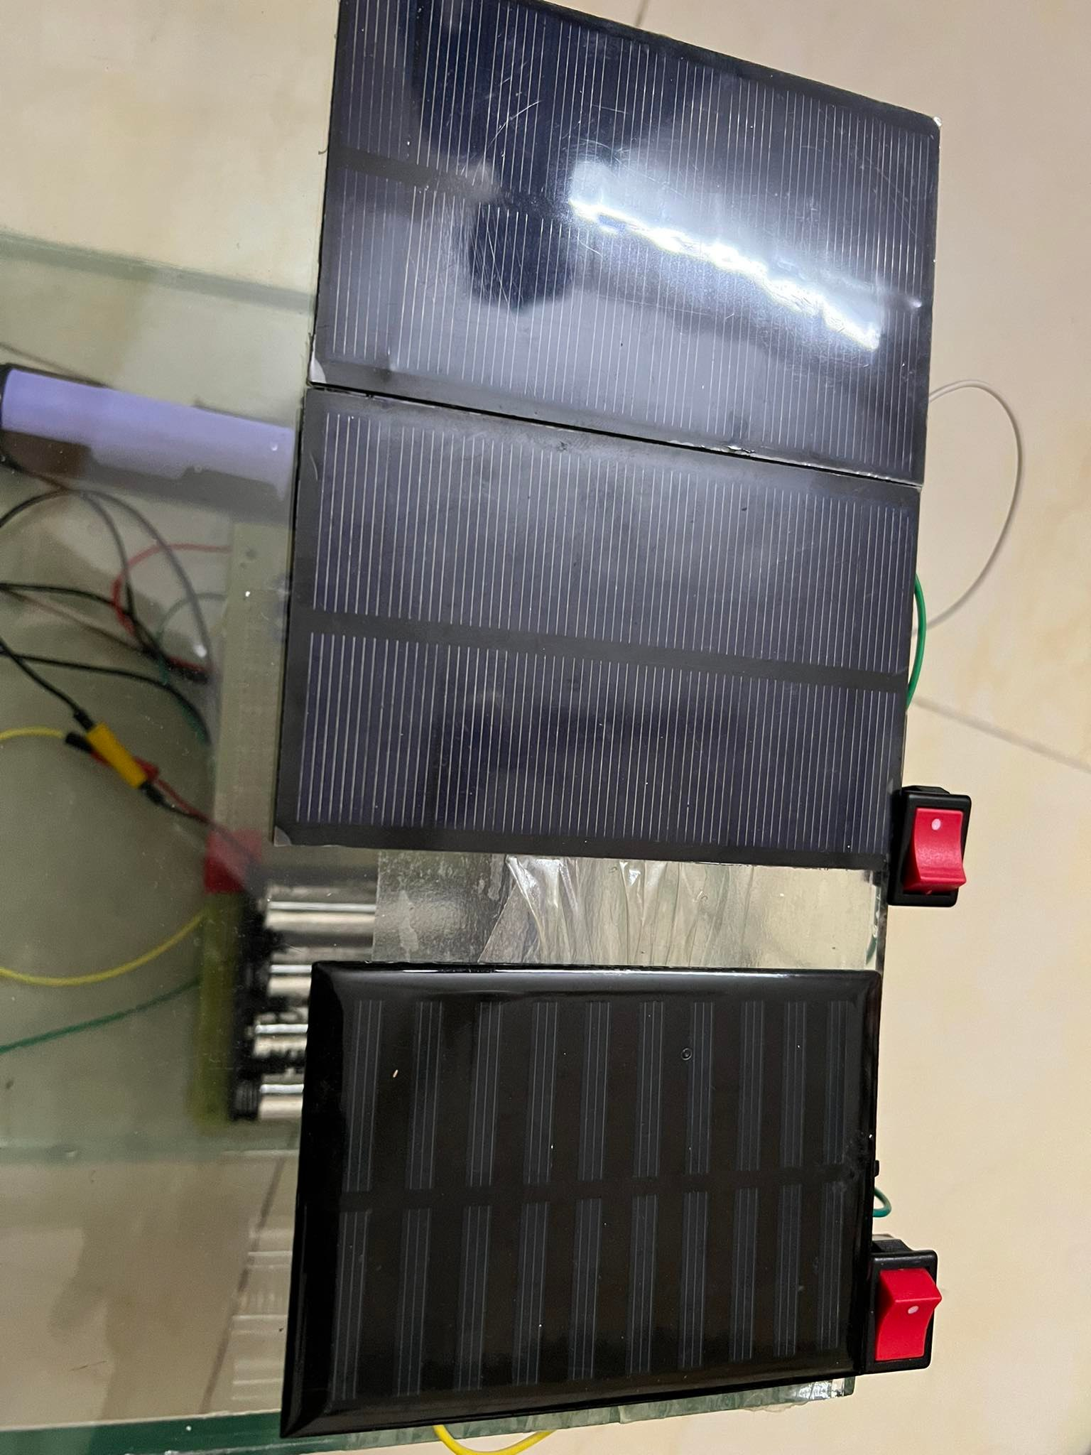
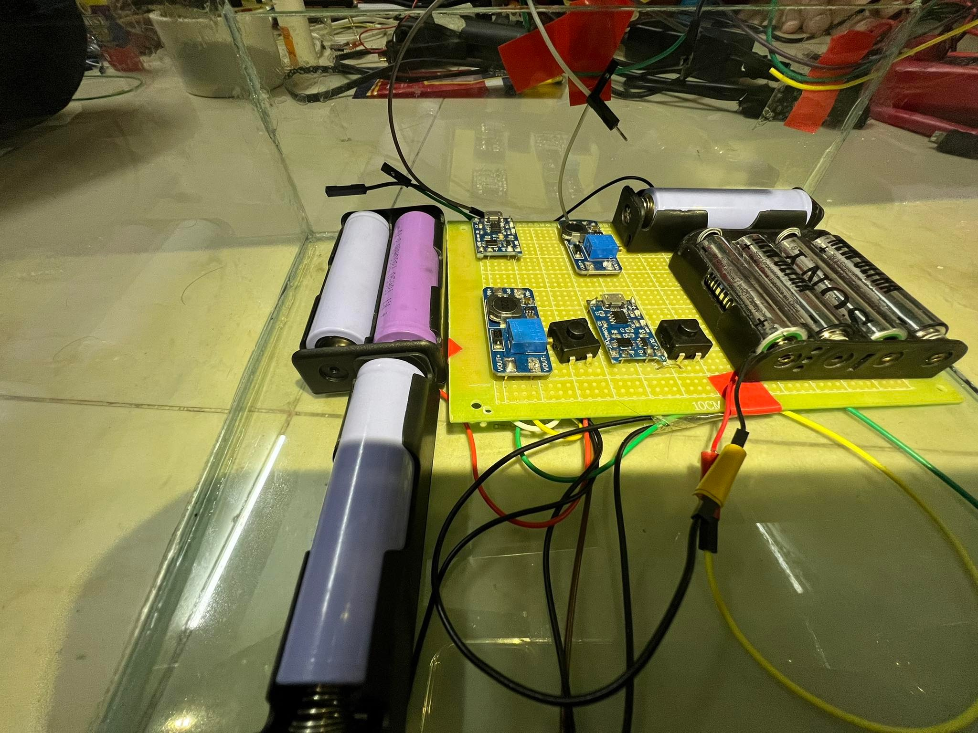
3.1 Design: Solar Power
Presented by: 1706189

Slide 11
3.1 Design: Data Access
The data from the sensors can be accessed in three ways two of which are remote.
1. From the mounted LCD on the circuit.
2. From ThingSpeak website integrated with the circuit
3. From SMS sent to the users personal phone number when parameters exceed a preset threshold.
Presented by: 1706189

Slide 12
3.1 Design: ThingSpeak
Data read from the sensors are directly uploaded to the ThingSpeak website in real time.
Users can see the temperature, humidity and air quality index at that moment and observe a chart of recent readings.
All the data uploaded are recorded and can be accessed at any time.
Presented by: 1706189

Slide 13
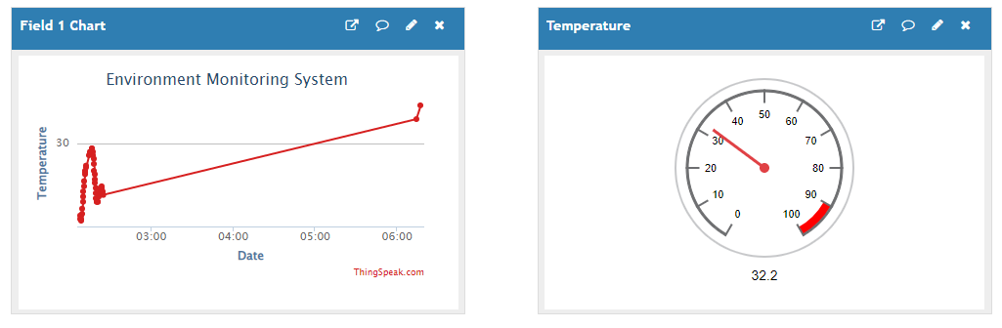
3.1 Design: ThingSpeak
Presented by: 1706189

Slide 14
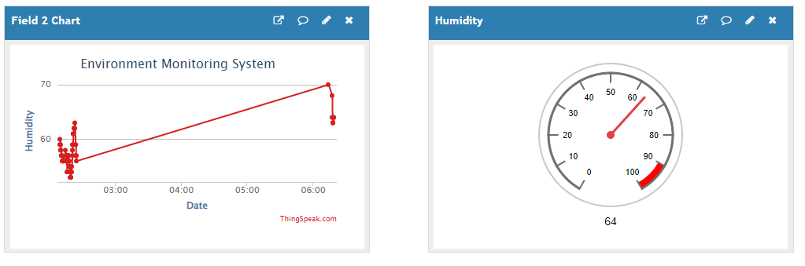
3.1 Design: ThingSpeak
Presented by: 1706189

Slide 15
3.1 Design: ThingSpeak
Presented by: 1706189

Slide 16
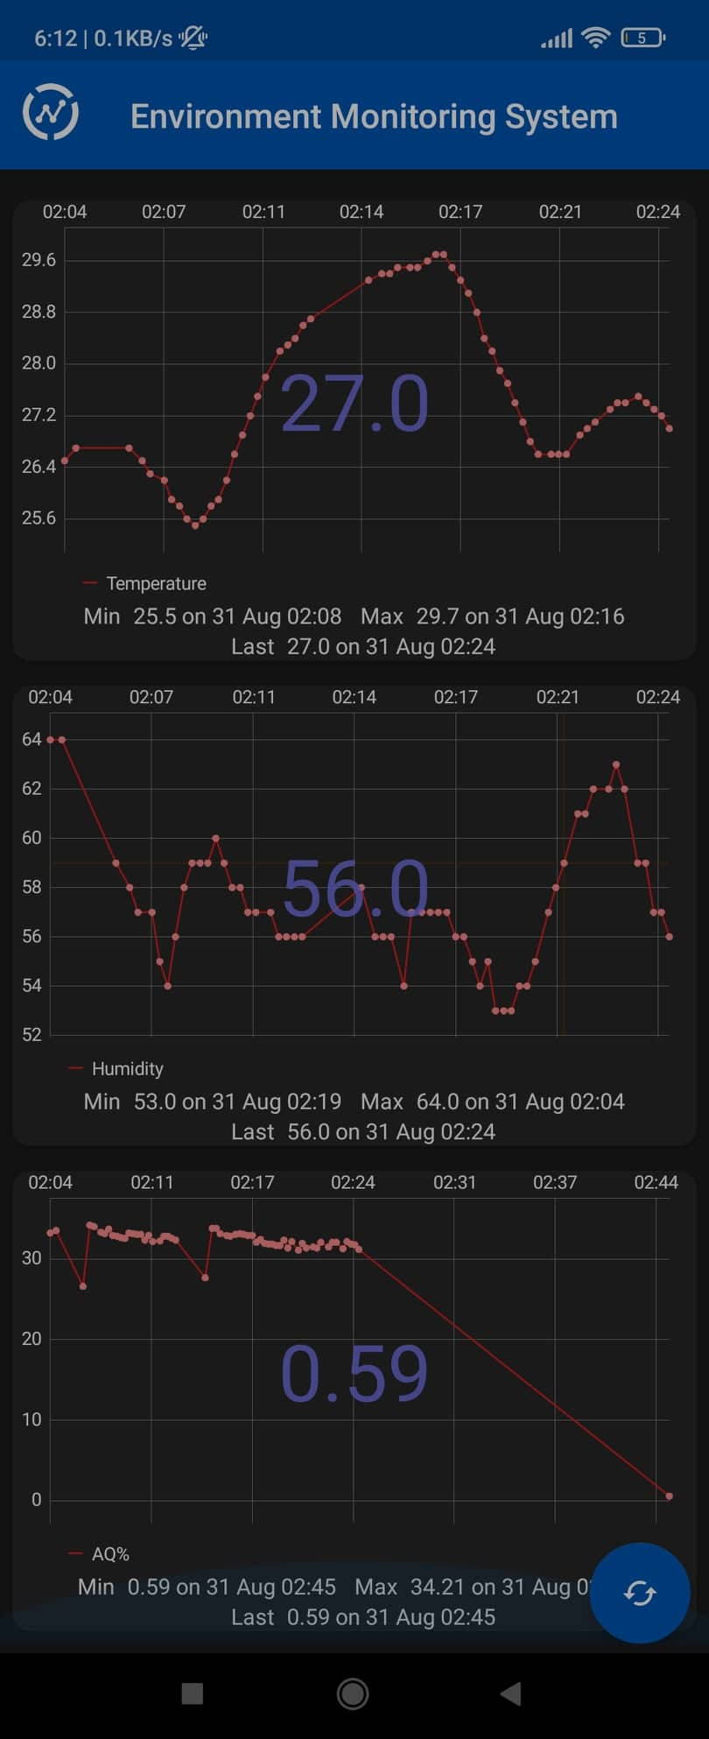
3.1 Design: ThingView
The affiliated app to ThingSpeak can be used to access the recent data as well.
All the data taken are at indoor conditions.
Presented by: 1706174

Slide 17
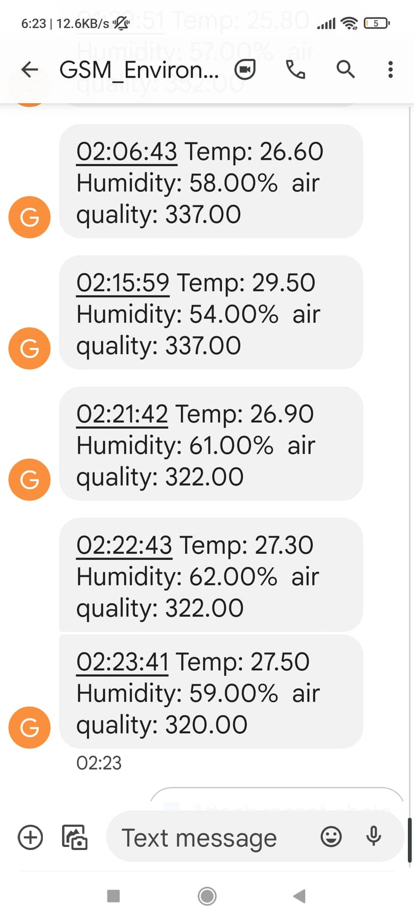
3.1 Design: GSM
The user can also receive an SMS briefly stating the data under specified conditions.
This design can be subject to further improvement
Presented by: 1706174

Slide 18
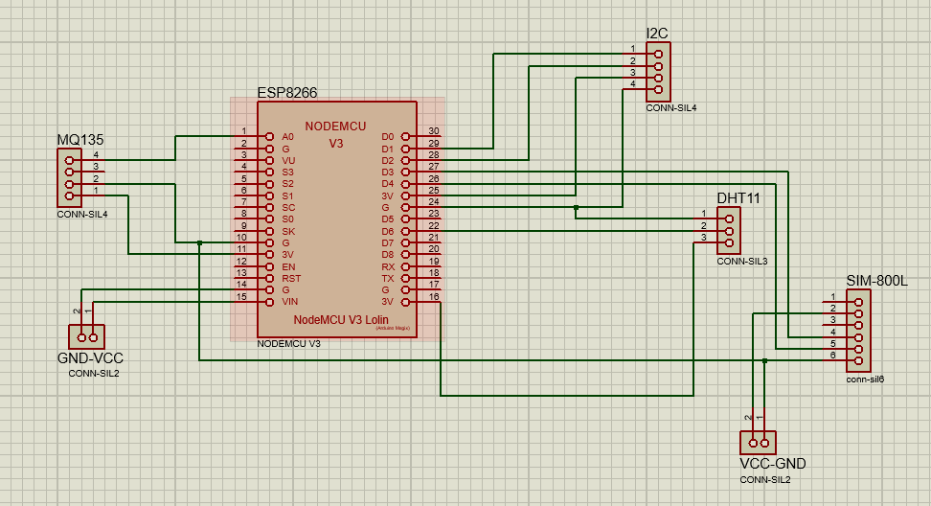
3.2 Design: Circuit Diagram
Circuit diagram of our project
Presented by: 1706174

Slide 19
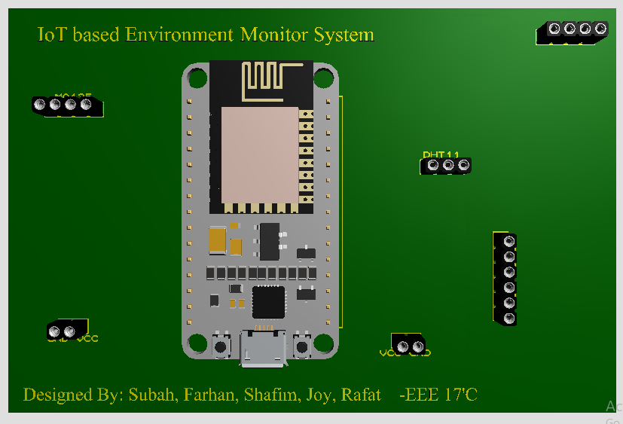
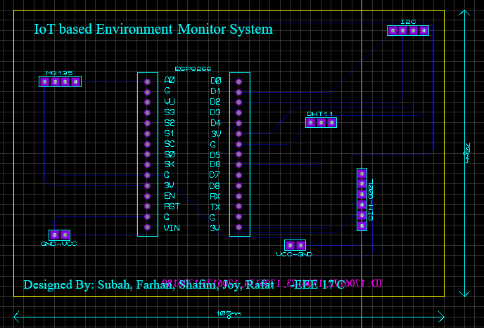
3.4 Design: PCB Layout and 3d rendering
The following figure shows the PCB layout and the 3D rendering of the main circuit.
Presented by: 1706174

Slide 20
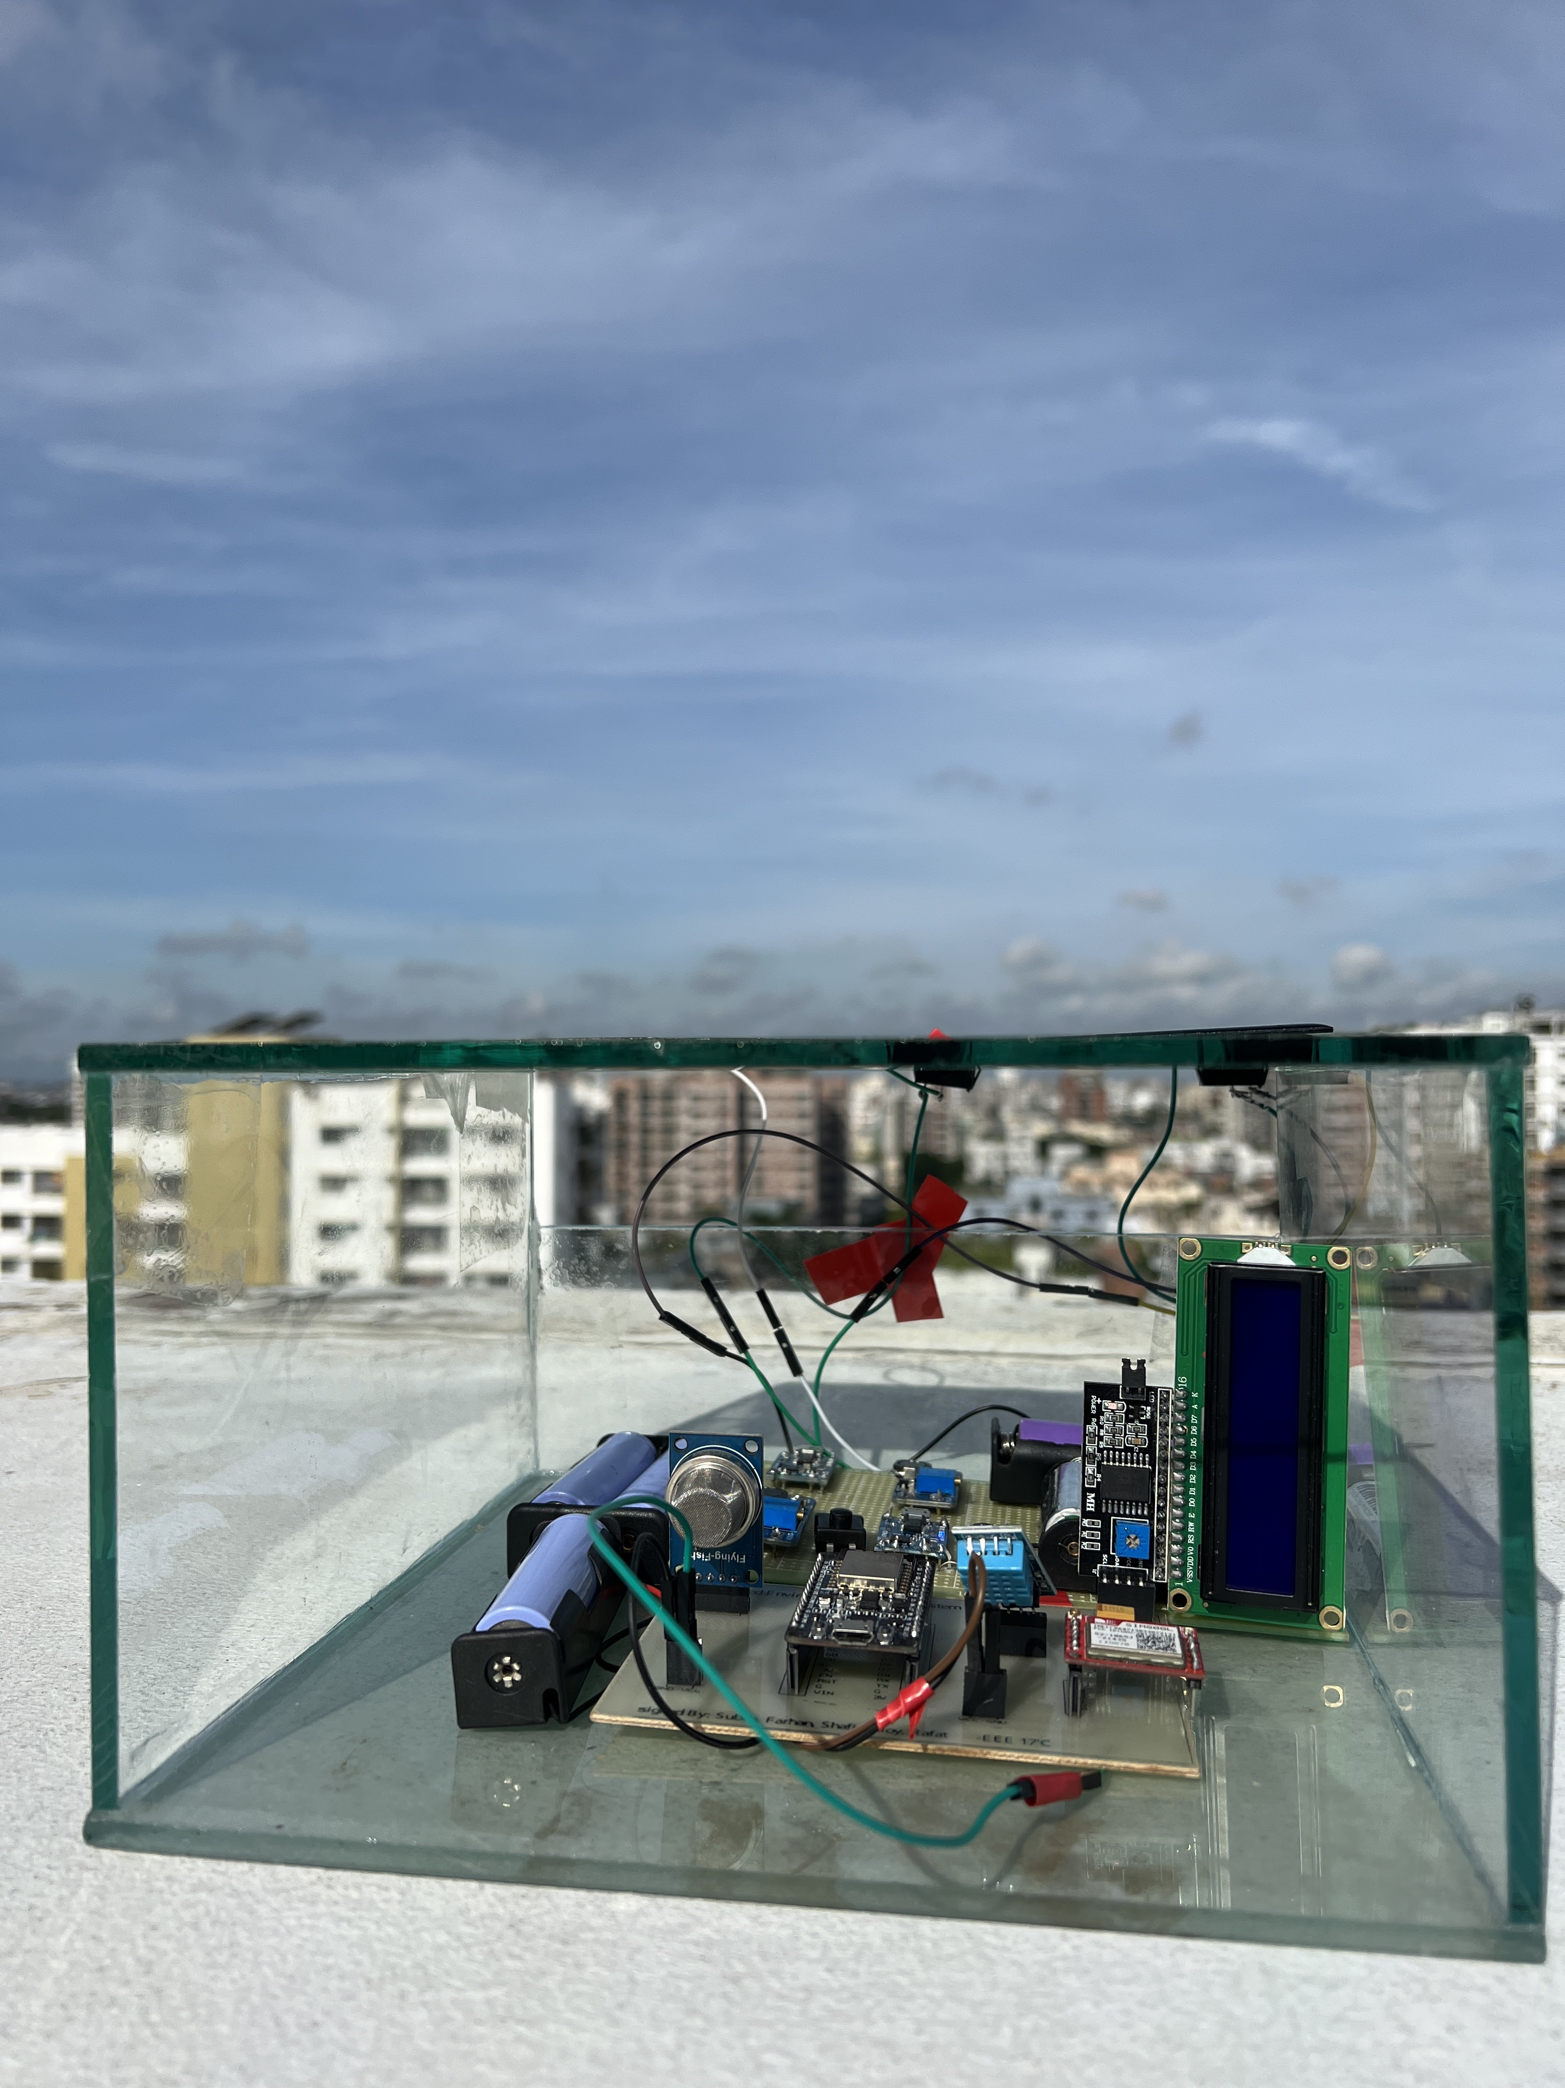
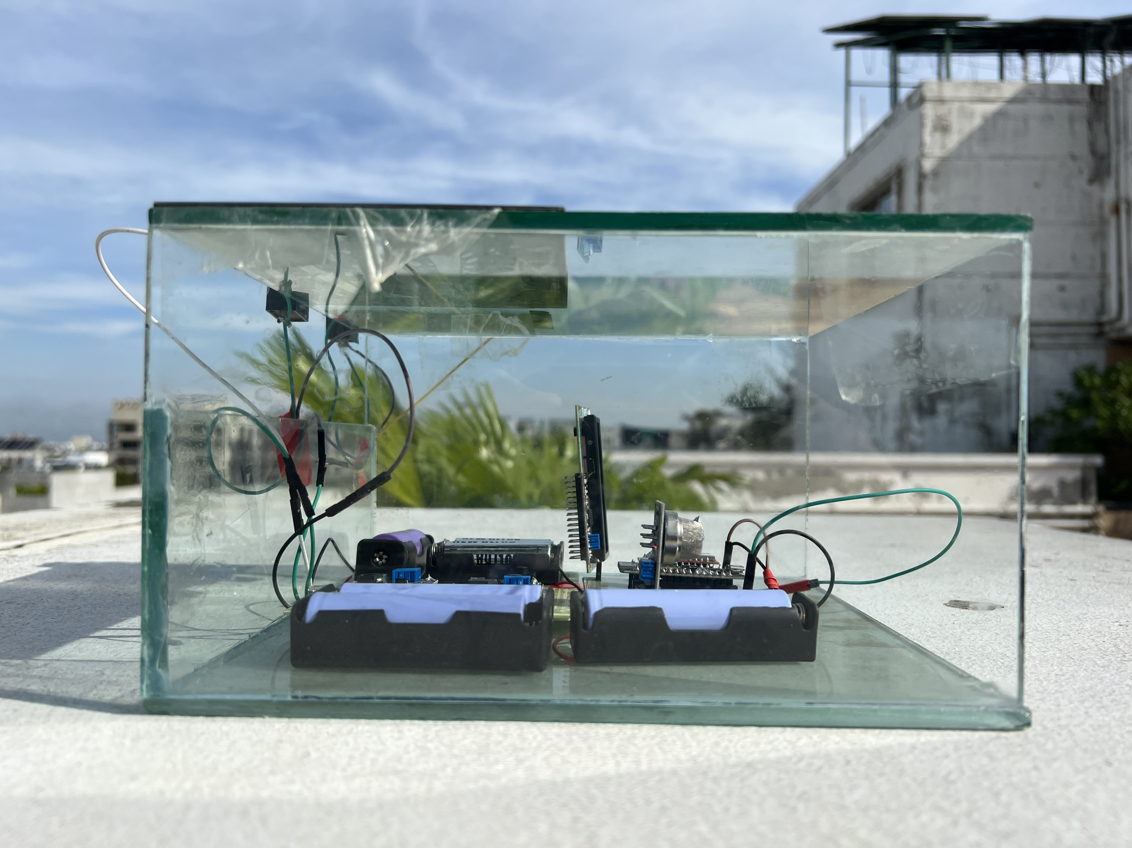
4.1 Implementation: Photo Gallary
Presented by: 1706174

Slide 21
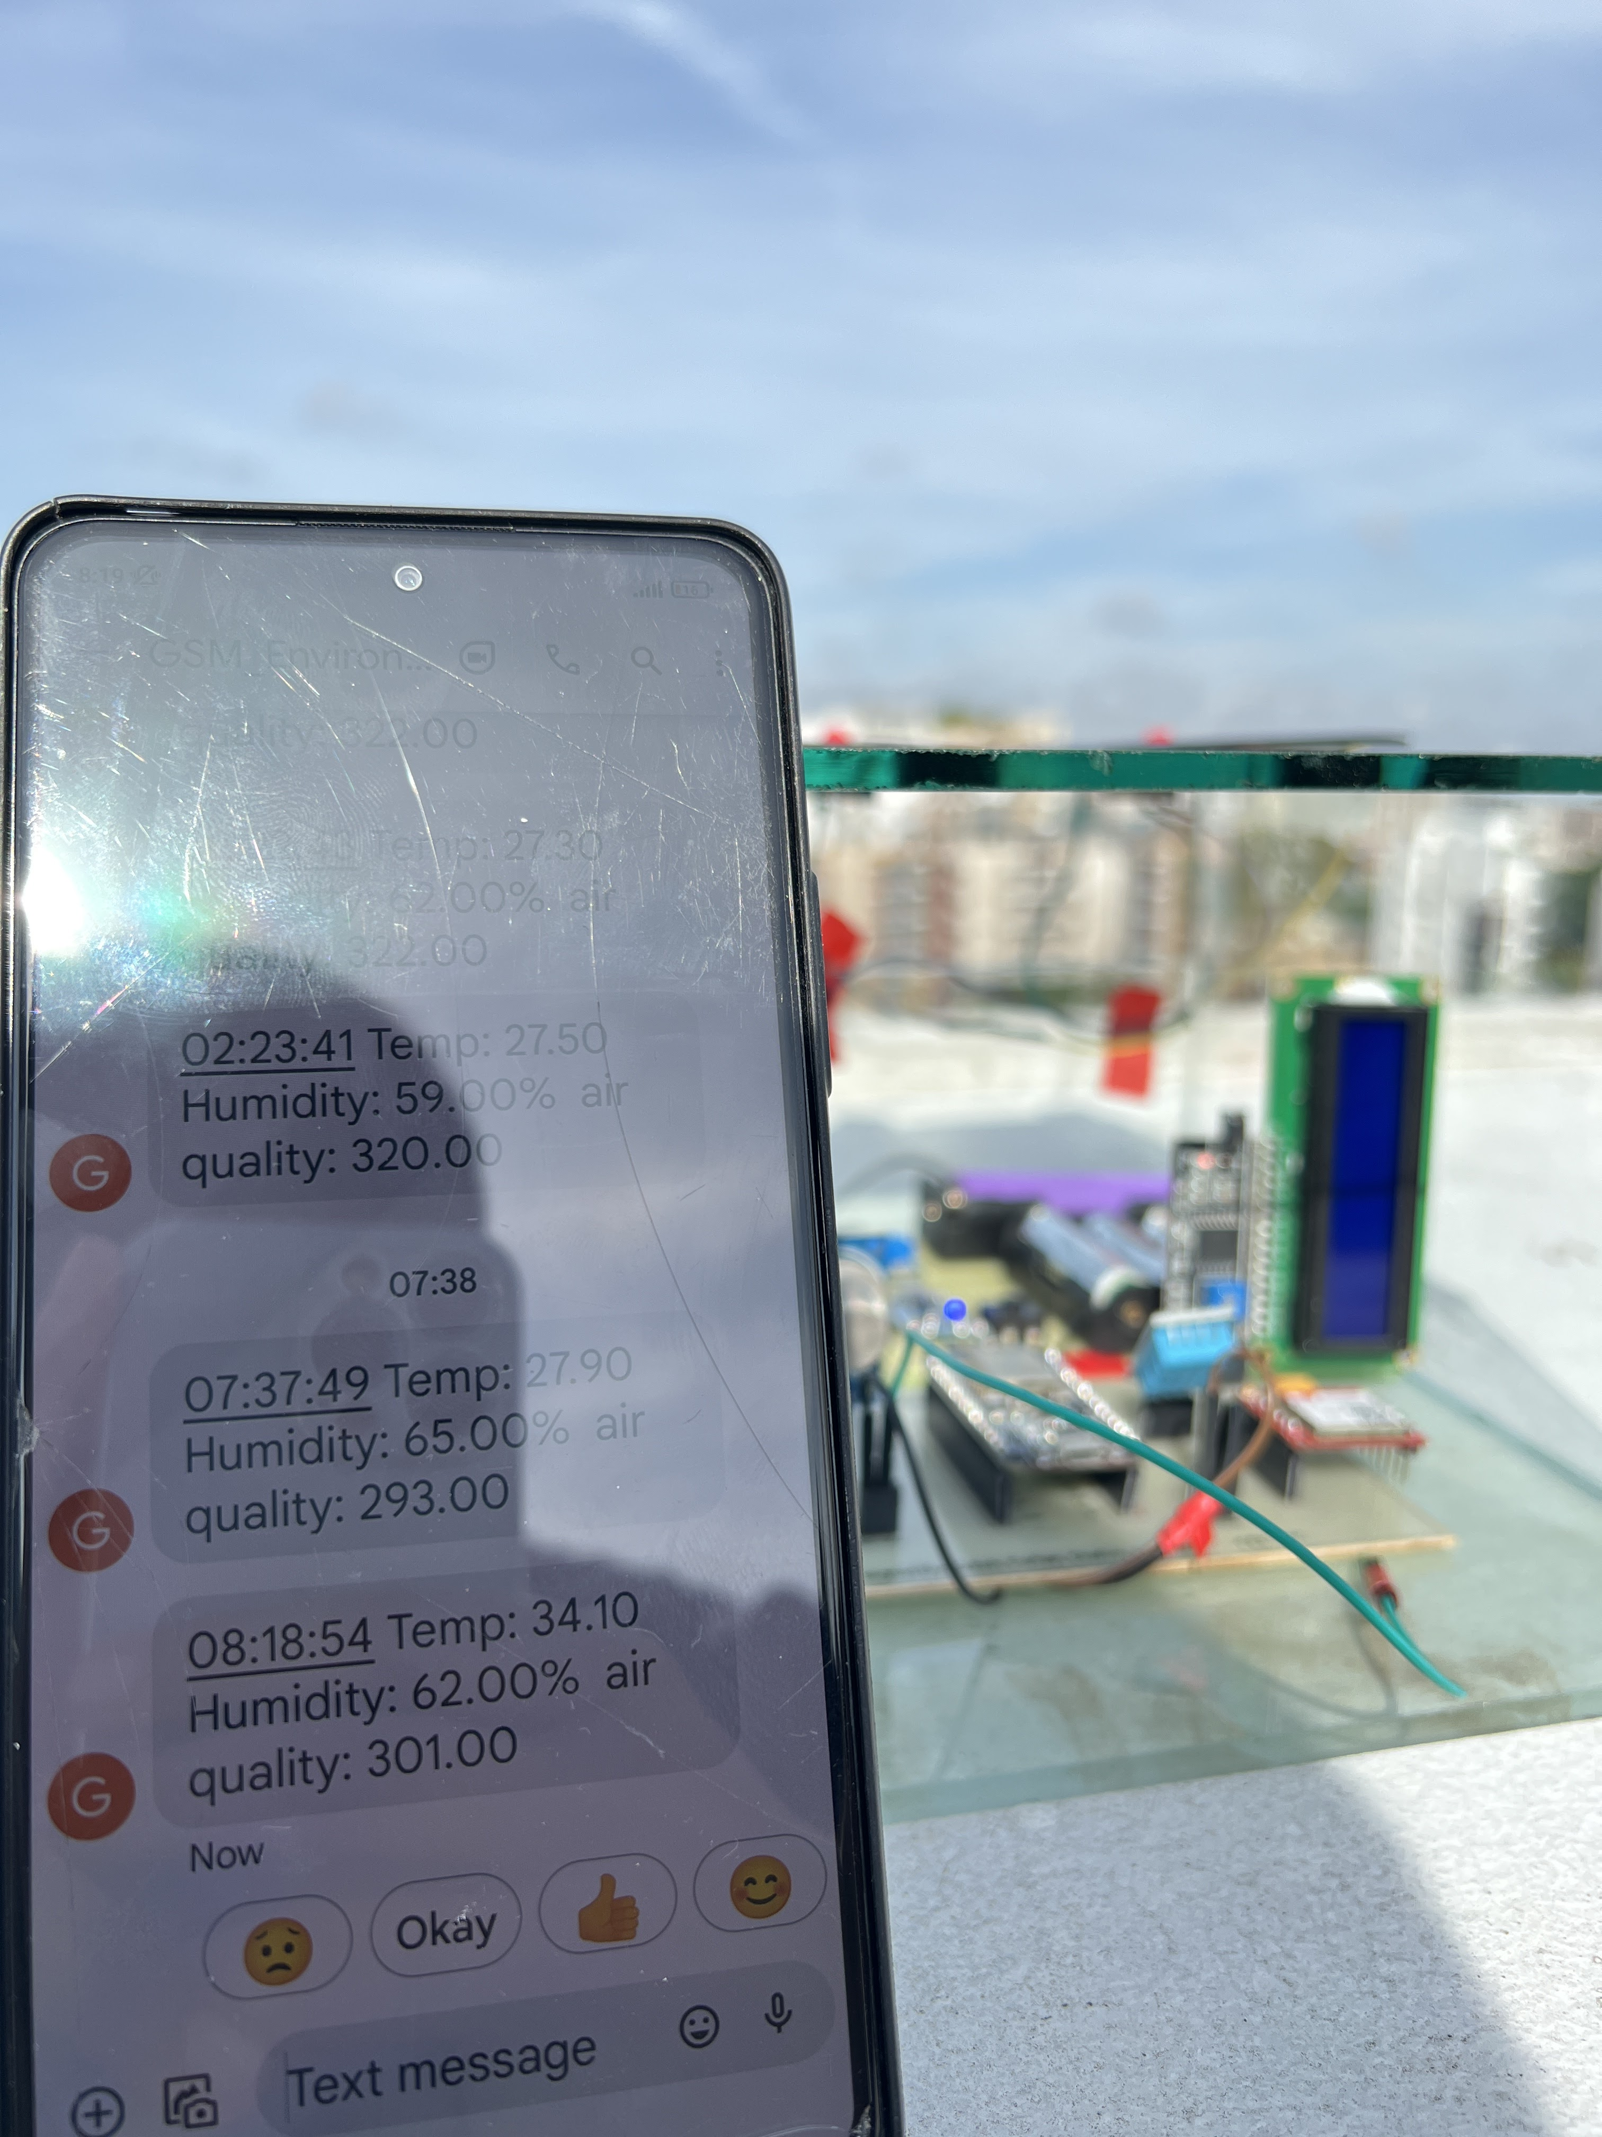
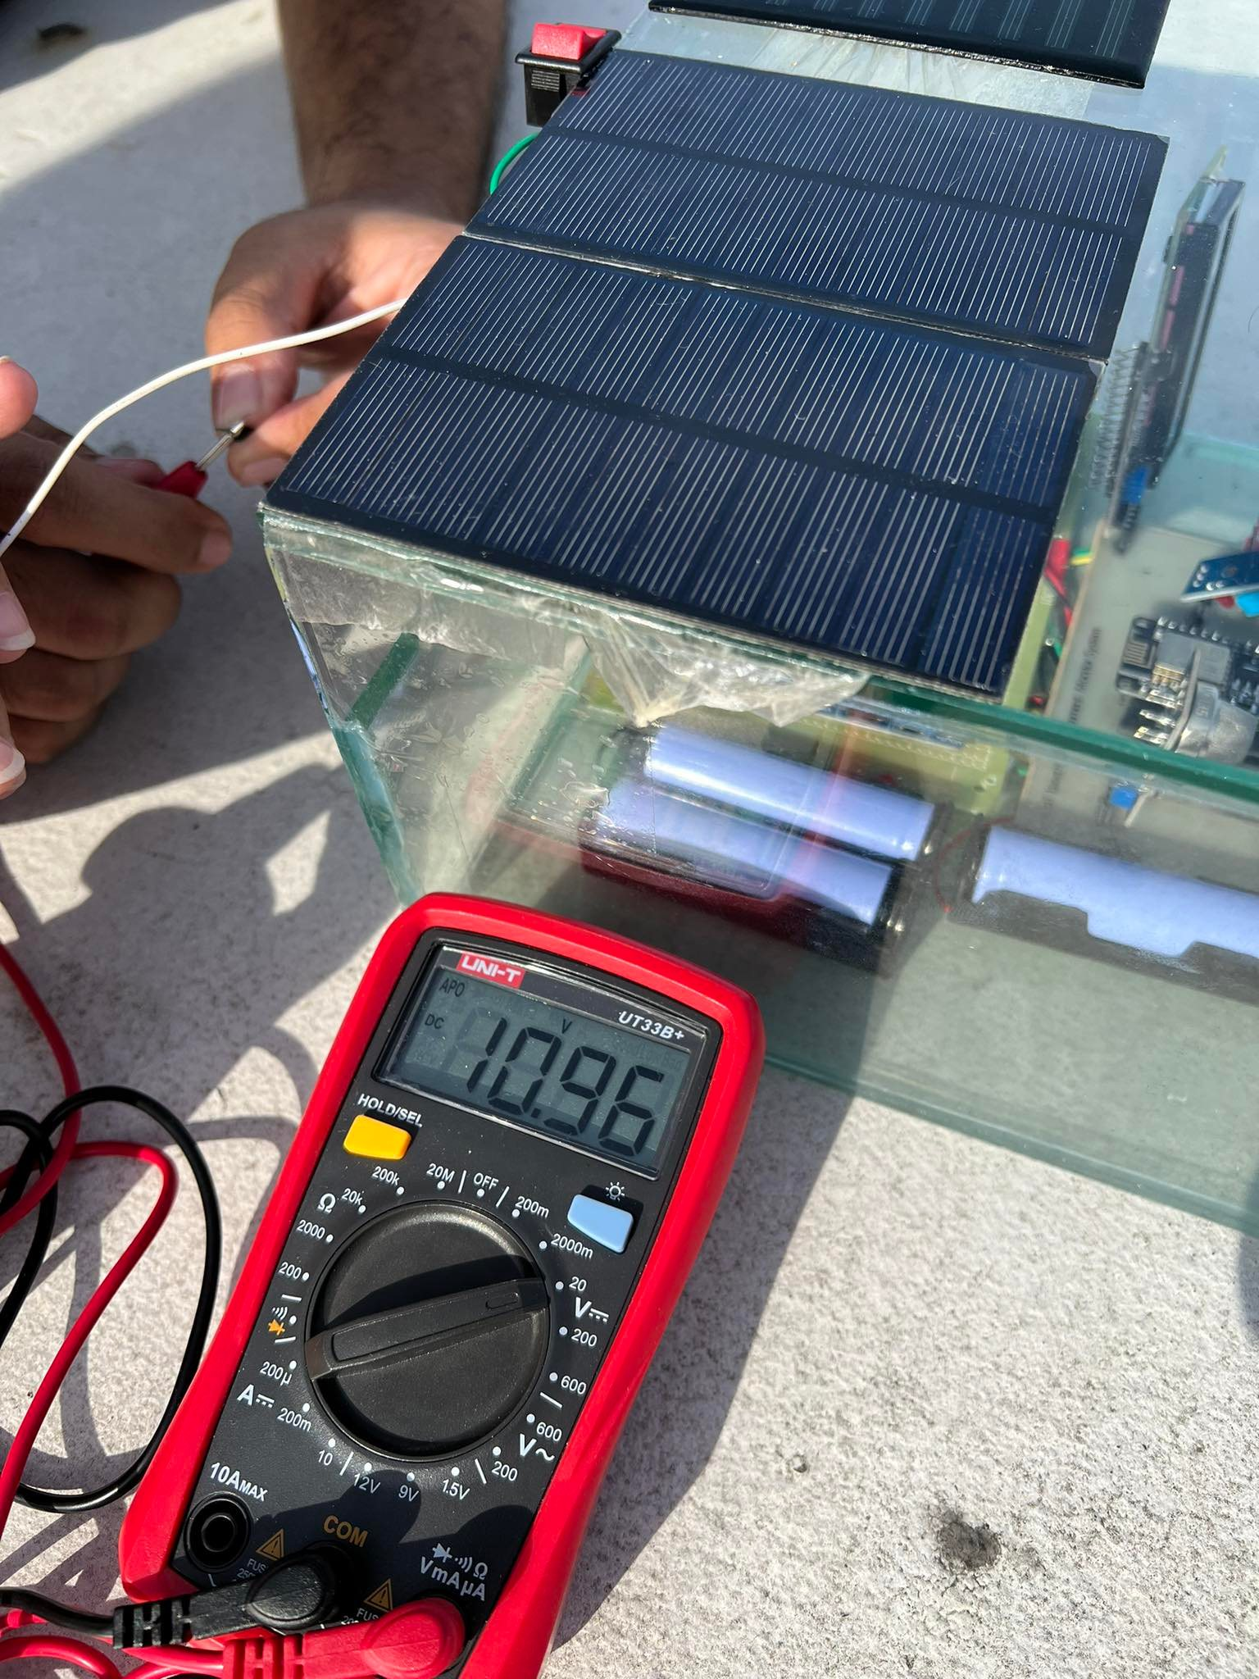
4.1 Implementation: Photo Gallery
Presented by: 1706174

Slide 22
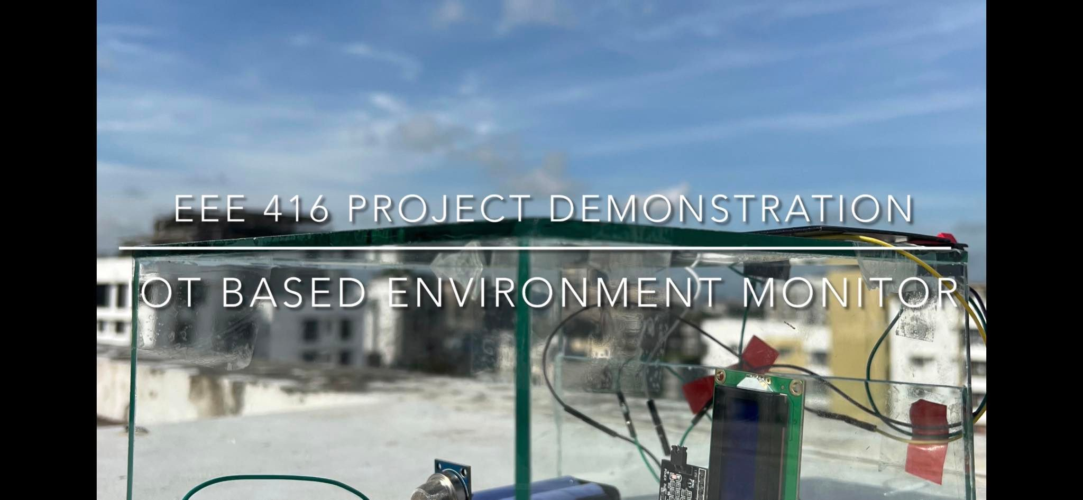
4.2 Implementation: External Links
YouTube Link: https://youtu.be/VbX1BqEhhpc
Presented by: 1706175

Slide 23
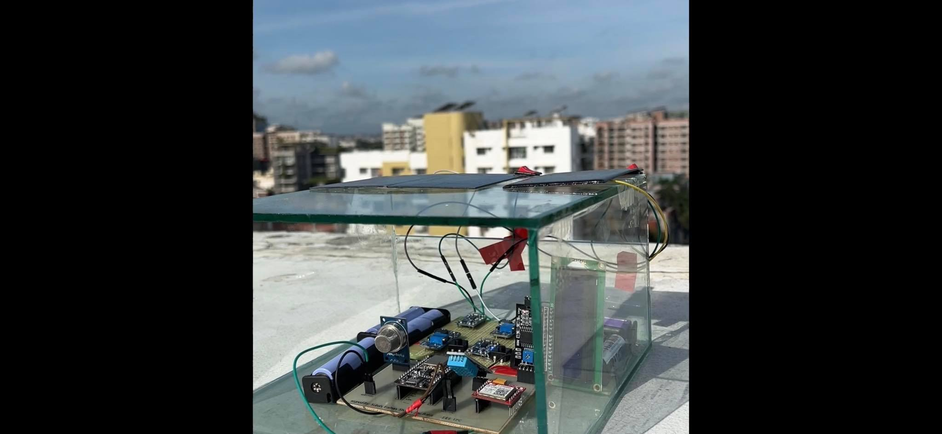
4.2 Implementation: External Links
YouTube Link: https://youtu.be/VbX1BqEhhpc
Presented by: 1706175

Slide 24
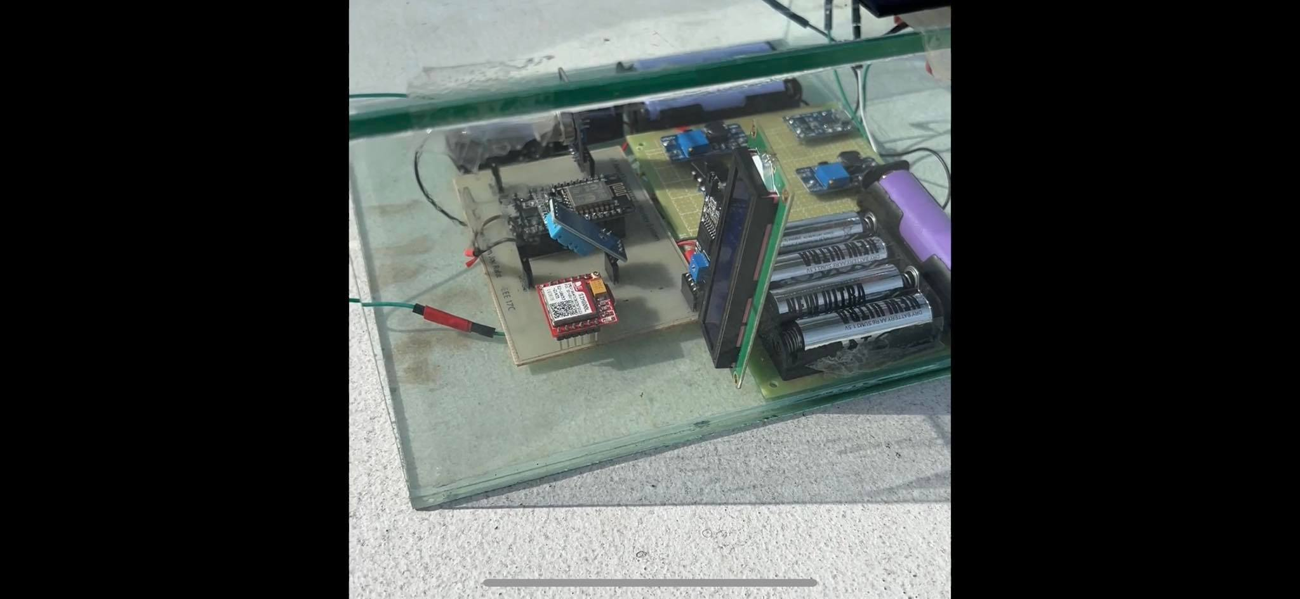
4.2 Implementation: External Links
YouTube Link: https://youtu.be/VbX1BqEhhpc
Presented by: 1706175

Slide 25
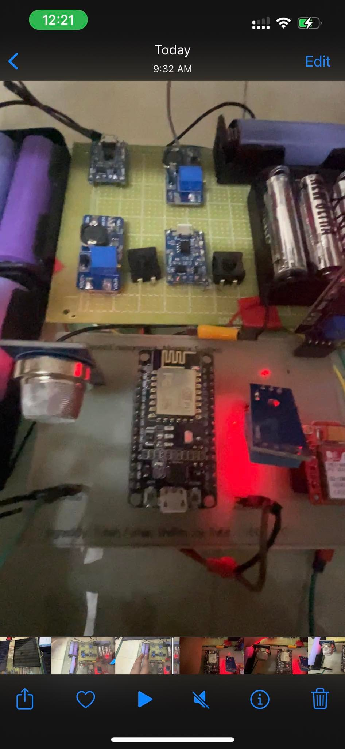
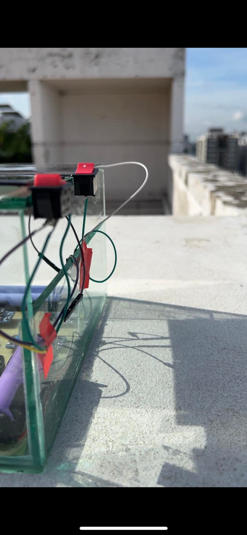
4.2 Implementation: External Links
Presented by: 1706175

Slide 26
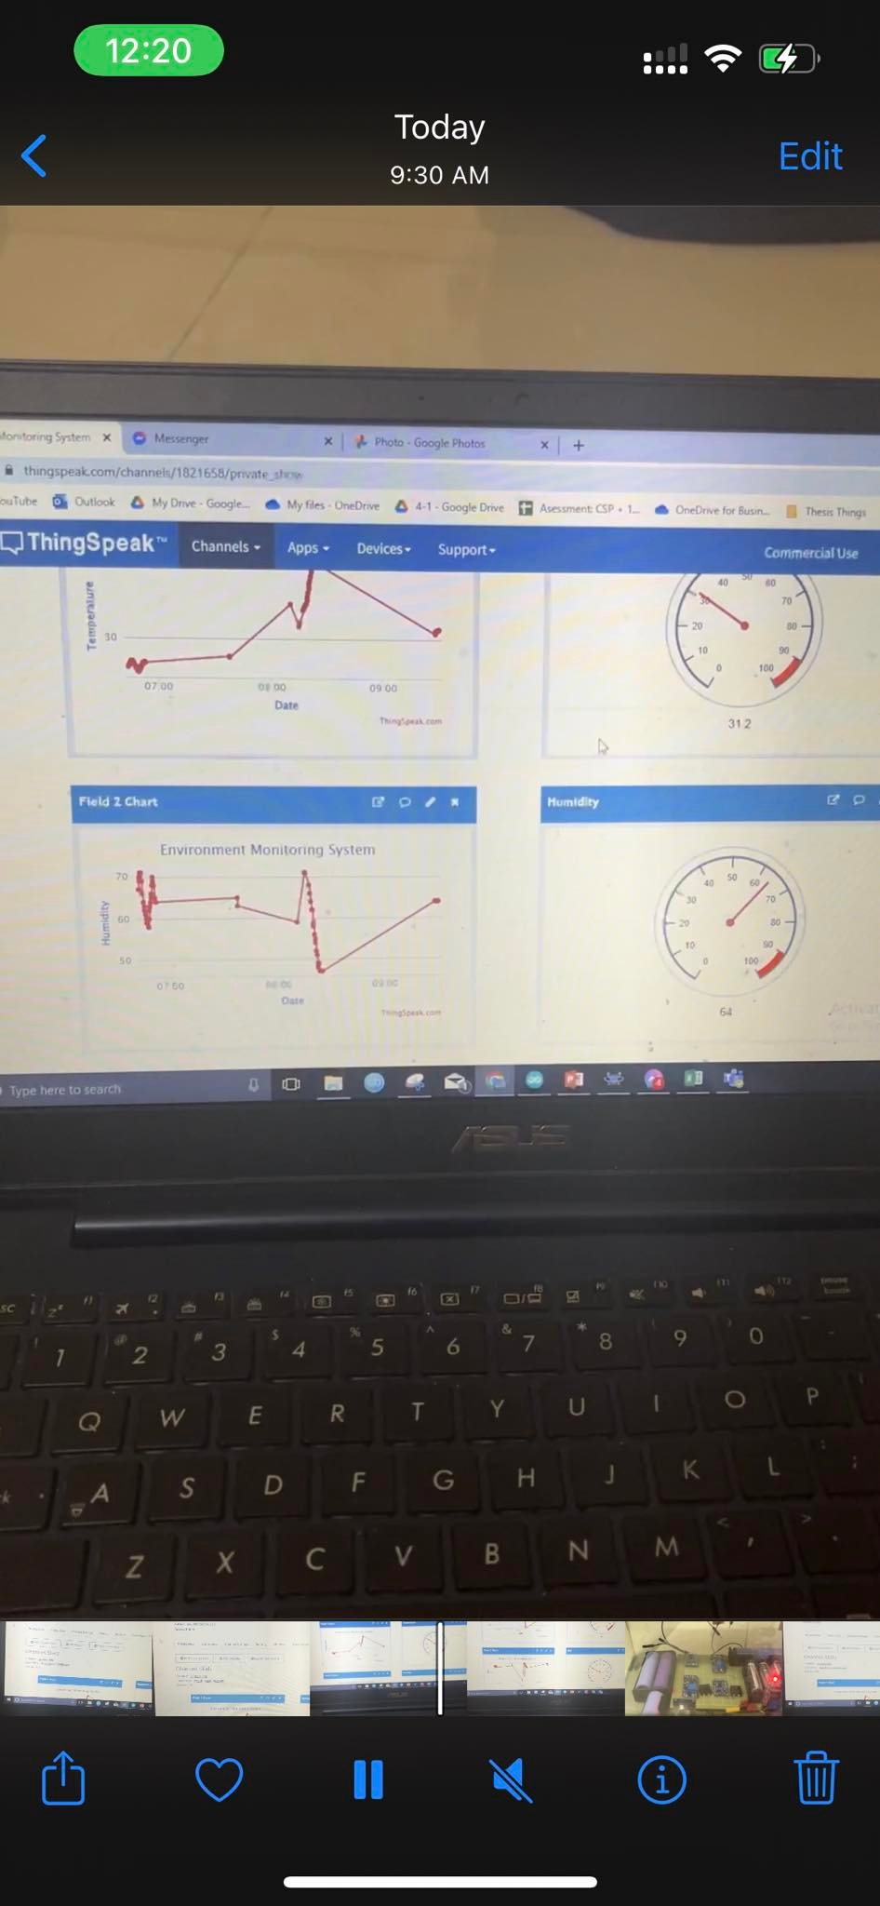
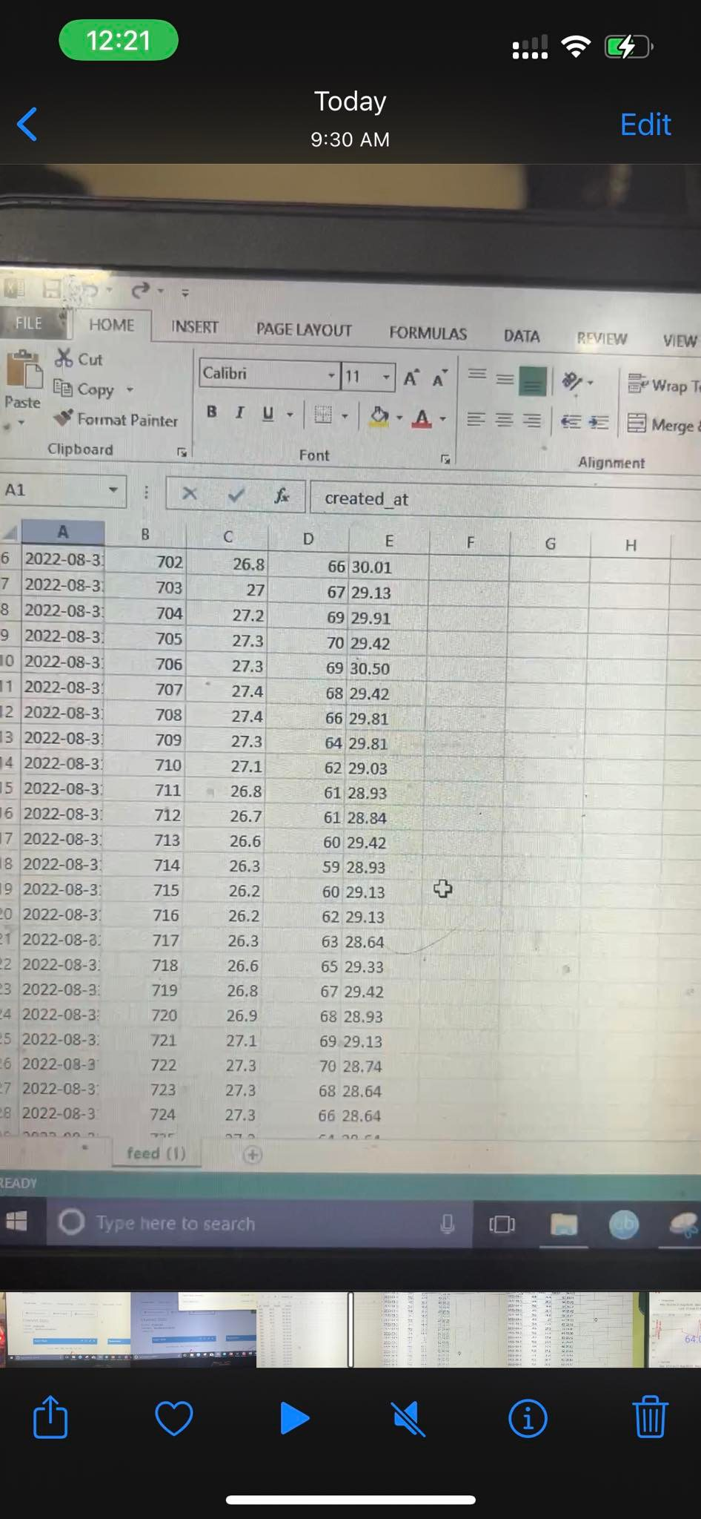
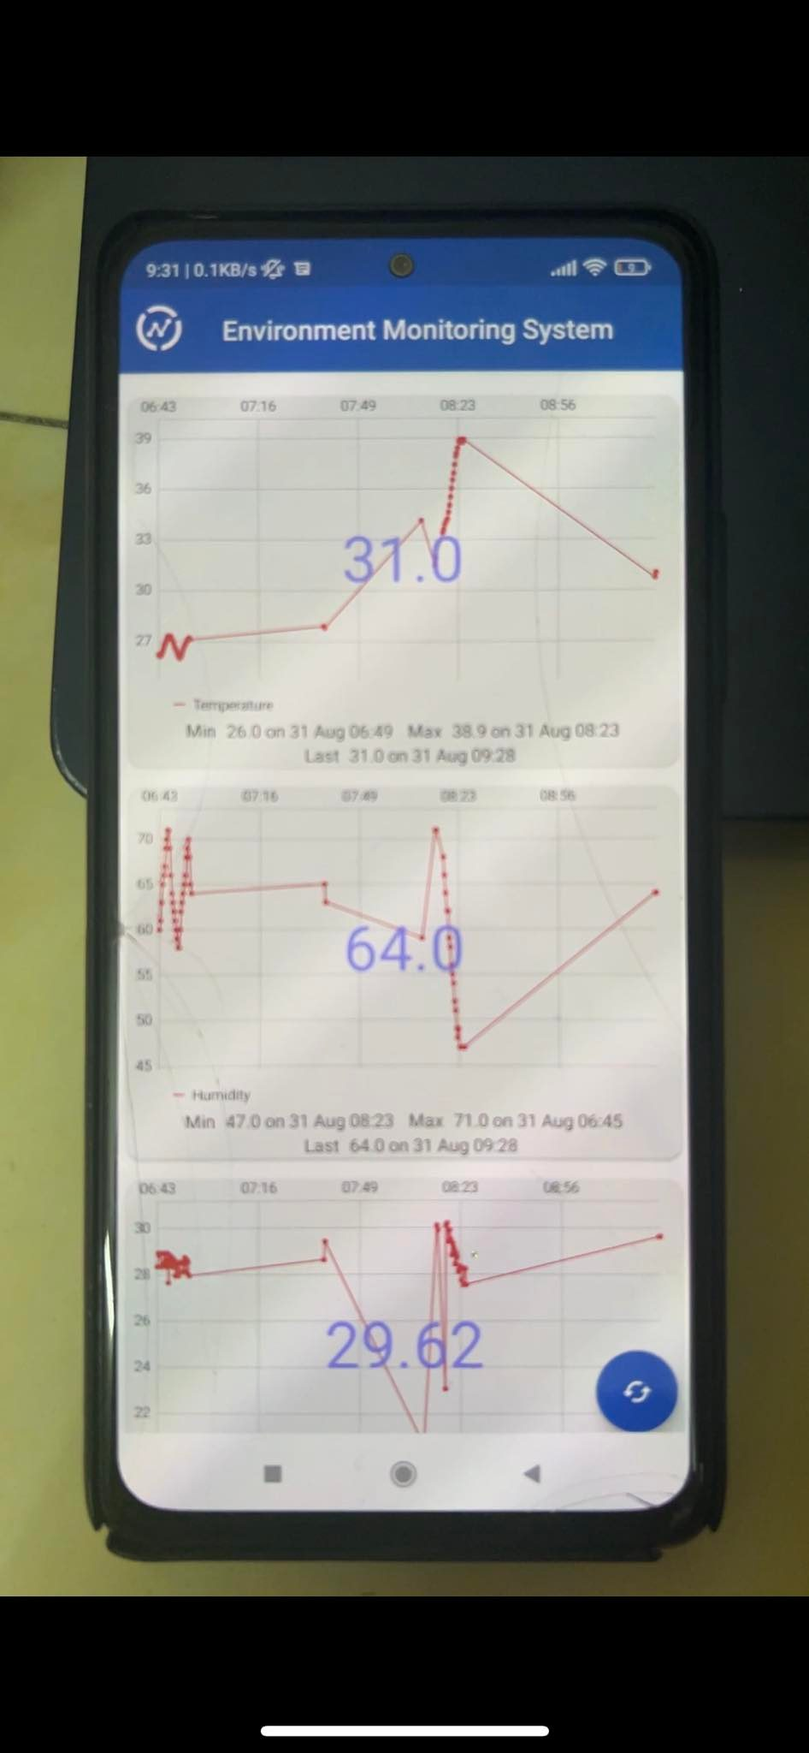
4.2 Implementation: External Links
Presented by: 1706175

Slide 27
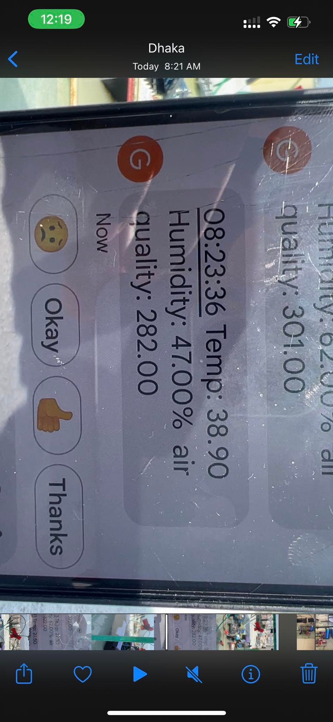
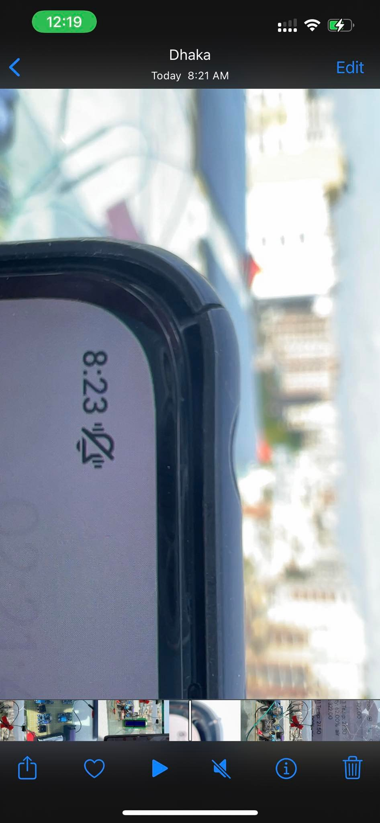
4.2 Implementation: External Links
Presented by: 1706175

Slide 28
5. Analysis and Evaluation
5.1 Novelty
5.2 Project Management and Cost Analysis
5.3 Practical Considerations of the Design
5.4 Assessment of the Impact of the Project
5.5 Evaluation of the Sustainability
Presented by: 1706172

Slide 29
5.1 Novelty
We have created a portable device that is run with clean solar energy and whose data can be accessed remotely in more than one way from any place any time as long as one has internet connection.
Presented by: 1706172

Slide 30
5.2 Project Management and Cost Analysis
Component | Quantity | Price per Unit (Tk) | Total Price (Tk)
ESP8266 | 1 | 432 | 432
DHT11 | 1 | 136 | 136
MQ135 | 1 | 200 | 200
SIM800L | 1 | 365 | 365
I2C module | 1 | 70 | 70
LCD display | 1 | 180 | 180
Solar Panel | 3 | 320 | 960
TP4056 battery charger | 2 | 25 | 50
MT3608 boost converter | 2 | 70 | 140
Battery+holder | 8 | 17.5 | 140
Presented by: 1706172

Slide 31
5.2 Project Management and Cost Analysis
Component | Quantity | Price per Unit (Tk) | Total Price (Tk)
PCB printing | 1 | 263 | 263
Soldering Cost | - | - | 1000
Miscellaneous | - | - | 500
Casing | 1 | 300 | 300
Transport | - | 800 | 800
TOTAL |  |  | 5536
NOTE: Only the components and quantities used in the finalized product are included in the cost analysis. Including all the faulty sensors, backup components and ruined ones; the actual cost of making this product is almost twice as much.
Presented by: 1706172

Slide 32
5.3 Practical Considerations of the Design
The sensor can be used to monitor air quality and environment temperature and humidity of both indoor and outdoor conditions. The end product is small and noiseless. The data can be accessed remotely.
The monitor system is solar powered with battery backup. Thus it does not pollute the surrounding environment in any way.
This monitor system can be used to maintain a healthy environment inside homes, schools, hospitals, workspace and factories.
Presented by: 1706172

Slide 33
5.4 Assessment of the Impact of the Project
For a city as dense and polluted as Dhaka, the air quality is a major concern for the health and livelihood of it’s people. This monitor can be made more compact and cheap for the use of regular people.
The alarming data seen from this sensor can be a wake up call for the common people regarding the pollution happening all the time around us.
Presented by: 1706172

Slide 34
5.5 Evaluation of the Sustainability
The monitor system is run entirely on renewable solar power. The monitor can run directly under sunlight at daytime and use the battery backup during the absence of sufficient sunlight or at night.
Presented by: 1706172

Slide 35
6.3 Logbook of Project
At the time of making this slide,763 entries have been uploaded to ThingSpeak from 3rd August 2022 to 31st August 2022.
Presented by: 1706172

Slide 36
THANK YOU! ANY QUESTIONS?

